Slide 1
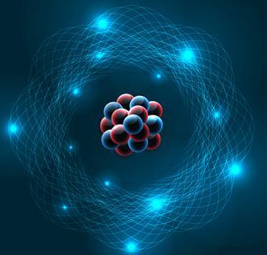



GENERAL CHEMISTRY Syllabus
: dvhan@hcmut.edu.vn
Lecturer: PhD. Đặng Văn Hân
: dvhan@hcmut.edu.vn
: 0915.030.385
: 112B2 – Inorganic Chemical Department

Slide 2





Welcome to General Chemistry!
Introduction
TARGET
Content &
SUBJECT STRUCTURE
Grading
REFERENCES
2

Slide 3
Introduction
Take a look around you: Chemistry is the science that describes everything you touch, see and feel. In this course, we will study:
The fundamental chemistry from the ground up, beginning with the basics of atom and its behavior;
Chemical bonding, molecular geometry, chemical formulas, …
Then, progressing to chemical properties of matter, and chemical changes and reactions that take place all time in our world.

Slide 4
Subject Target
By the end of this course, you will:
1. Understanding the basic principles of General chemistry;
2. Be able explain basic, everyday chemical phenomena and apply this knowledge to solving real-world problems;
3. Be able to explain why chemical is important and how it applies to everyday life.

Slide 5

1. Substance structure
Contents
Modern knowledge in atomic structures;
Chemical periodic of elements;
Chemical bonding and molecular geometry;
3. Experimental Technique
2. Chemical processes
Laboratory regulations;
Practice using apparatus – chemicals;
Dissolution tech., quantification, solution titration;
Calculations and errors;
Confront results between theory and experiments.
Thermochemistry, Enthalpy, Entropy, △G;
Chemical equilibrium and effective factors;
Reaction rates and effective factors;
Solutions and properties.

Slide 6

Course Structure
Course Introduction (Week 1)
Chapter 1: Atomic Structure (Week 1-2)
Chapter 2: Chemical Periodicity (Week 3)
Chapter 3: Bonding Theories & Molecular Geometry (Week 4-5)
TA Class for Midterm Exam (Week 6)
Chapter 4: Thermochemistry (Week 7-8)
Chapter 5: Kinetic Chemistry (Week 9)
Chapter 6: Chemical Equilibrium (Week 10-11)
Chapter 7: Solutions and Properties (Week 12-13)
TA Class for Final Exam (Week 14-15)

Slide 7
Contents for Midterm Examination
Chapter 1: Atomic Structures
Atomic Orbital (AO)
4 quantum numbers (n, l, m_{l} , m_{s})
Electron configuration and arrangement
Chapter 2: Chemical Periodicity
Periodic structure
General properties
Chapter 3: Chemical Bonding & Molecular Geometry
Basic concepts in chemical bonds
Valence bonding in VB theory

Slide 8
Contents for Final Examination
Chapter 4: Chemical Thermodynamics
Basic concepts
Reaction heat, Enthaypy (∆H), Hess law, Entropy (∆S), Free Gibb energy (∆G)
Chapter 5: Chemical Kinetics
Basic definition
Reaction rate and effective factors
Chapter 6: Chemical Equilibrium
Equilibrium constant (K_{eq}), Relationship of K_{eq} & ∆G
La Chatelier Principle
Chapter 7: Solutions and Properties
Fundamental concepts
Dilute solution and properties
Vapor pressure, boiling and freezing temperature

Slide 9

GRADING
1. Midterm Examination (MULTIPLE CHOICES): 20% (30 questions in 50 min)
Chapter 1: Atomic Structure
Chapter 2: Periodic Table
Chapter 3: Chemical Bonding
2. Final Examination (MULTIPLE CHOICES): 50% (40 questions in 70 min)
Chapter 4: Thermochemistry
Chapter 5: Kinetic Chemistry
Chapter 6: Chemical Equilibrium
Chapter 7: Solutions and Properties
3. BIG ASSIGNMENTS:10%
4. LABORATORY: 20%
6

Slide 10

BIG ASSIGNMENT (10%)
There are TWO partial assignments during this subject:
1st Homework (Midterm Exam) + 2nd Homework (Final Exam);
Do online on your Bkel website;
Each assignment, you have TWO opportunities to do your homework. The highest score in 2 times will be taken.
The final score of this component is the average of TWO partial homework.
6

Slide 11
IMPORTANT NOTICES
In Laboratory:
WEAR Lab coat before ENTERING the chemical Laboratory;
Attend all classes of this part.
In Our Class:
Do your two homework assignments during the required time on the Bkel website;
You will be UNABLE to pass this course if you MISS ANY GRADING COMPONENTS (Midterm, Final, Big Assignment, Experiment).
Activity Bonus:
Check your attendance randomly 1 time in Midterm period → 0.5 point in M. exam;
Twice in Final period → 0.5 point in Final exam.
6

Slide 12
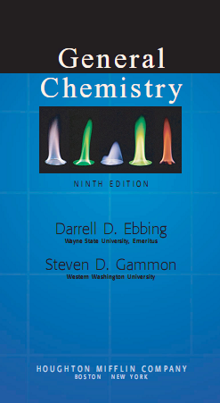
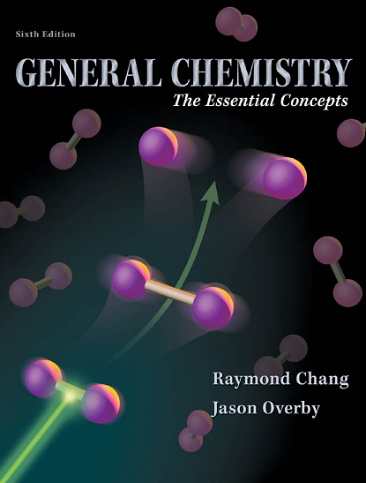



REFERENCES
Power Point Lectures will be posted on the BKeL
21

Slide 13

I believe that your General Chemistry will be easier!!!

